Slide 1
Predicting Spotify Charting Success
Hannah Hill, Jasmine Jones, Alexis Bloor

Slide 2
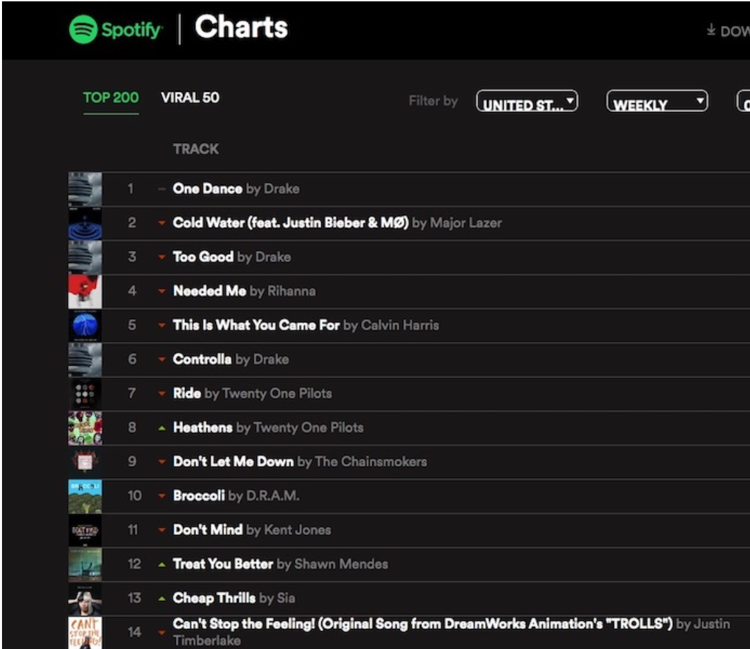
Overview
Objectives: This project aims to develop machine learning models, which are able to predict two outcomes related to the popularity of a song on the platform Spotify: 1) whether the song in question will chart in the Spotify Top 200 rankings, and 2) if so, for how many weeks will it remain in the Top 200 chart.
These models will use features of songs, collected from the Spotify API, including tempo, loudness, danceability, duration, ect. to predict successful outcomes. These models could be used by music artists and producers to gauge how likely their newest records are to achieve Top 200 status.

Slide 3
Tasks
Retrieving and cleaning data
Sources:
Randomly Selected Database of Spotify songs (10,000 per 26 genres) https://www.kaggle.com/zaheenhamidani/ultimate-spotify-tracks-db?select=SpotifyFeatures.csv
Top 200 Spotify Chart 2020-2021 https://www.kaggle.com/sashankpillai/spotify-top-200-charts-20202021?select=spotify_dataset.c sv
Testing Song Predictions:
Web Deployment:
HTML/Javascript Flask-based application that allows users to input music features and outputs the predictions of the models
Logistic Regression, K-Nearest Neighbors clustering, Random Forest Decision Trees

Slide 4
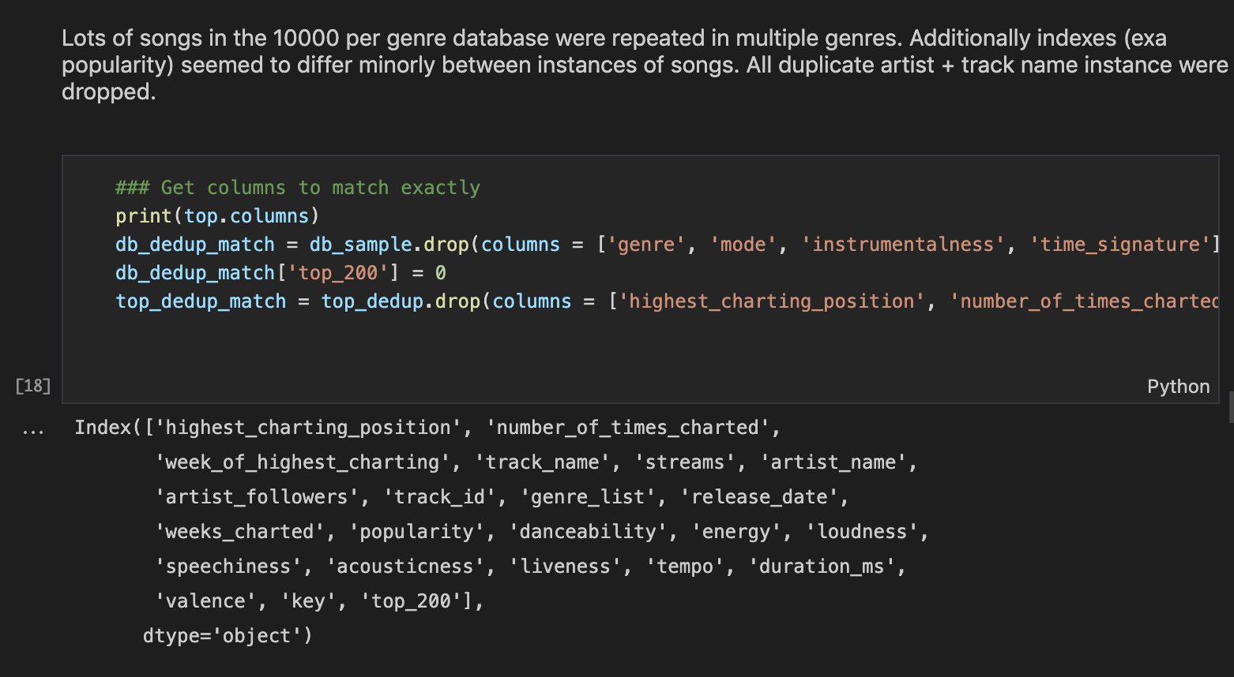
Dropped duplicates
Renamed column names in both csv’s (top 200, top 10000 genres) to match names in both data sets
Merged both data sets
Binned similar keys together to avoid error

Slide 5
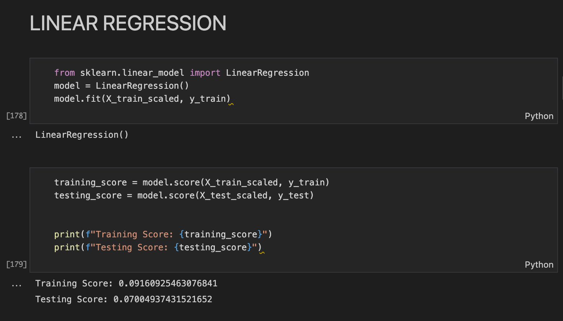
For “Number of weeks predicted to chart” we first did Linear regression for a numerical outcome
Errors from model testing, with Linear Regression (training and testing scores below 0.010)
Decided to bin weeks into 4 categories

Slide 6
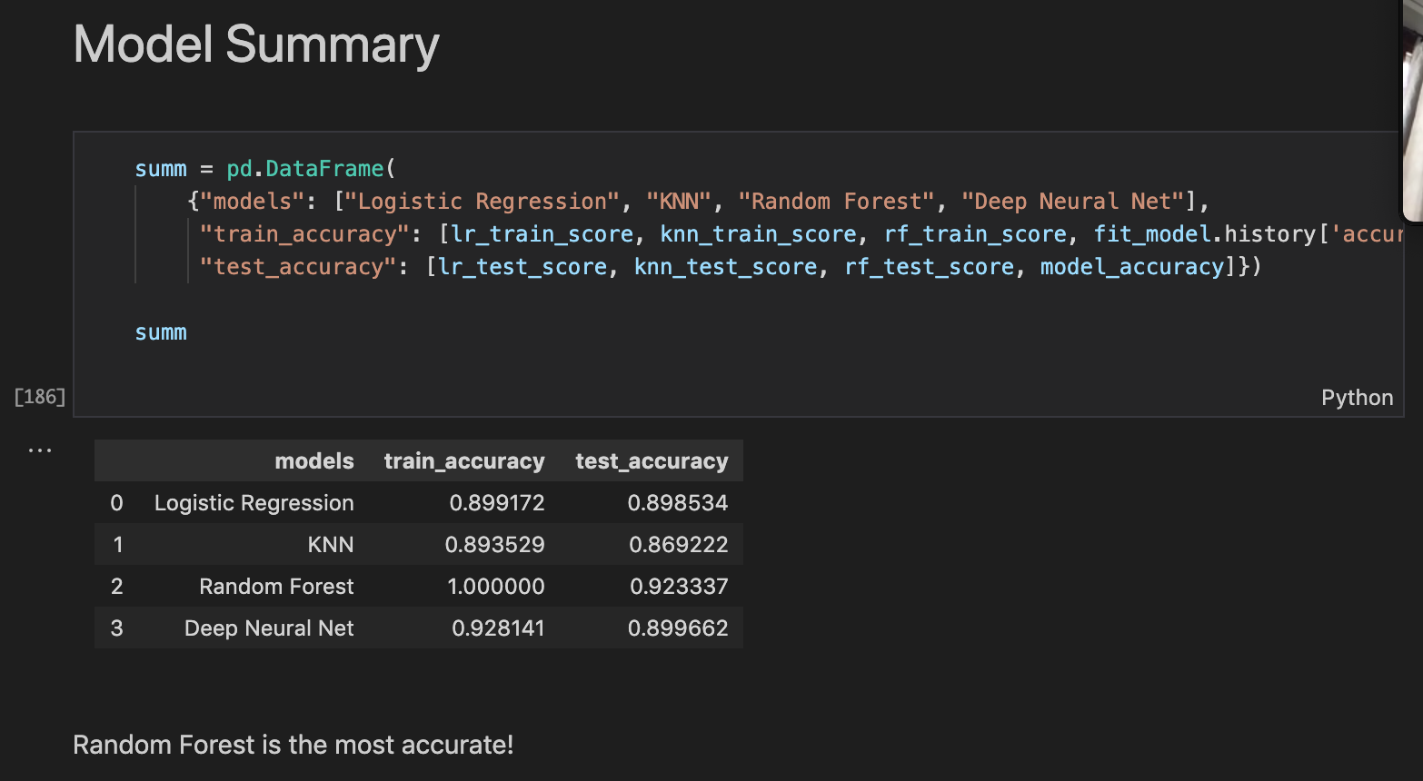
Random Forest model best predicts if a song will make the top 200 list on Spotify

Slide 7
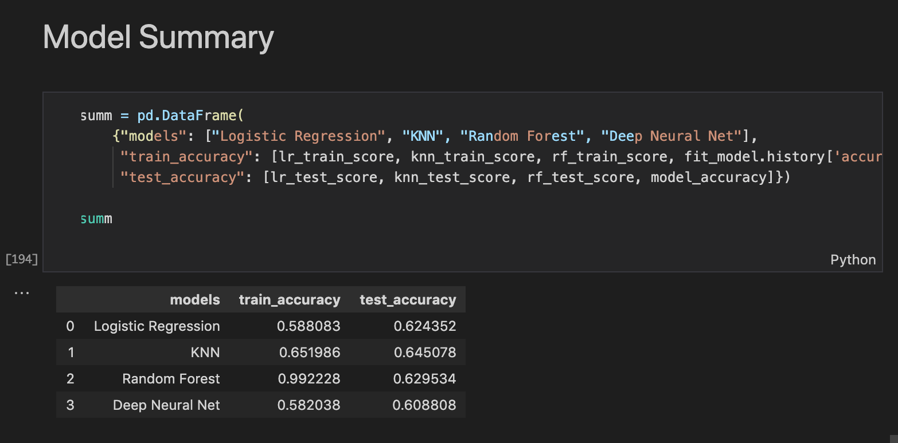
Random forest had the best training score, but the KNN had the best testing accuracy score
Concluded KNN best predicts how long a long will hold its spot on the top 200 so

Slide 8
